Slide 1



Discover Bologna
TIPS & ESSENTIALS

Slide 2
Contents
  1 - Welcome to Italy and Bologna
  2 - Getting Around – Transport, maps, app
  3 - Essential Documents – Passport, visa, insurance
  4 - Health and Safety – Emergencies
  5 - Accommodation – Finding housing, contracts, utilities
  6- Informations about Institute of Radioastronomy

Slide 3
Contents
  7 - Food and Drink – Local cuisine, markets, restaurants
  8 - Culture&Social Life – Traditions, events, meeting people
  9 - Daily Life – Shopping, banking, post office
  10 - Language Tips – Useful phrases, communication
  11 - Useful Apps and Websites for events and culture
  Follow us!

Slide 4
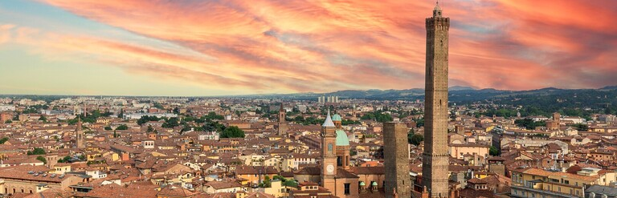
Back to index
1 - Welcome to Italy and Bologna
  Brief introduction to the city and Italian culture
  Short history and interesting facts about Bologna
  Tips for settling in and what to expect during your first days

Slide 5
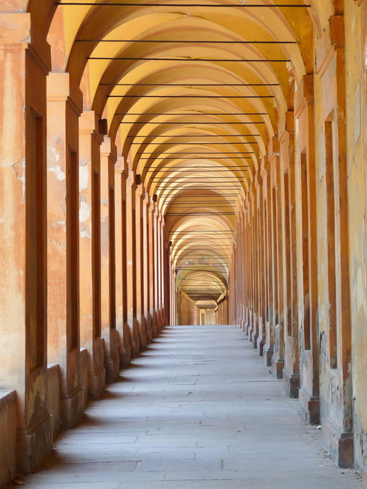
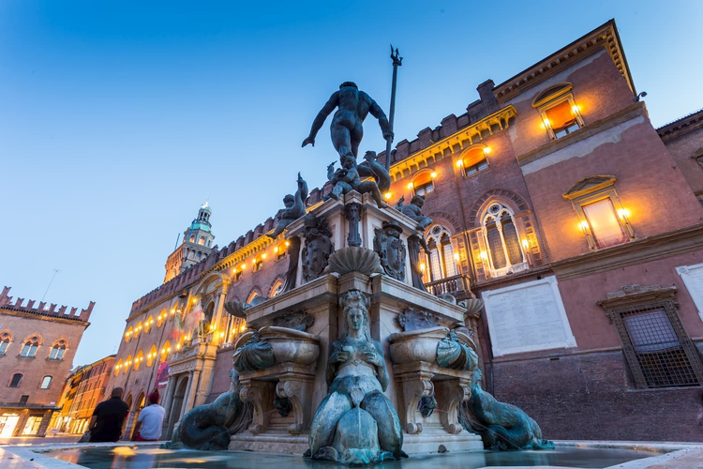
Back to index
BOLOGNA, IN PARTICULAR, IS FAMOUS FOR
Italy is known for its rich history, culture, and cuisine.
its medieval architecture, porticoes, and vibrant student life.The Porticoes of Bologna
A UNESCO World Heritage Site and one of the city's defining features. Stretching for almost 62 km, they are perfect for exploring Bologna in any weather.
Bologna combines all three, offering a unique blend of medieval heritage, academic tradition, and world-famous food
When you first arrive, take some time to explore the city visit the historic center, and get a feel for local customs and rhythms.
NEPTUNE FOUNTAIN
(FONTANA DEL NETTUNO)
One of Bologna’s most recognizable landmarks, standing beside Piazza Maggiore since the 16th century.
Click the image to learn more

Slide 6
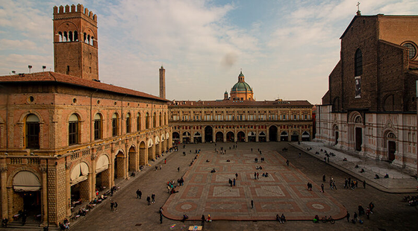
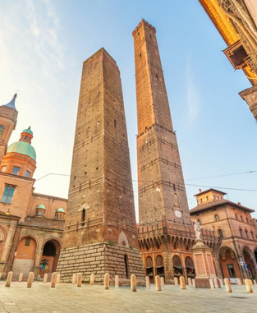
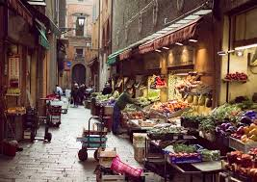
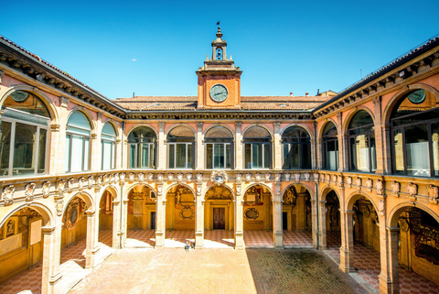
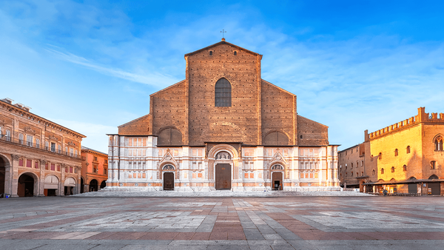
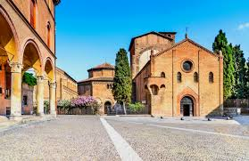
Back to index
PIAZZA MAGGIORE
THE TWO TOWERS
(ASINELLI AND GARISENDA)
The vibrant heart of Bologna, surrounded by some of the city's most important historic buildings, including Palazzo d’Accursio, the Basilica of San Petronio, and Palazzo dei Notai.
The iconic symbol of Bologna.
The Asinelli Tower can be climbed for stunning panoramic views over the city.
QUADRILATERO MARKET DISTRICT
ARCHIGINNASIO OF BOLOGNA
The historic home of the University of Bologna, featuring the renowned Anatomical Theatre.
A lively area of medieval streets filled with traditional food shops, local products, and authentic Bolognese atmosphere.
BASILICA OF SAN PETRONIO
BASILICA OF SANTO STEFANO
A unique complex of interconnected churches, often called the "Seven Churches," and one of the city's most atmospheric sites.
One of the largest churches in Europe, renowned for its impressive architecture, remarkable artworks, and unique unfinished façade.
Click the image to learn more

Slide 7
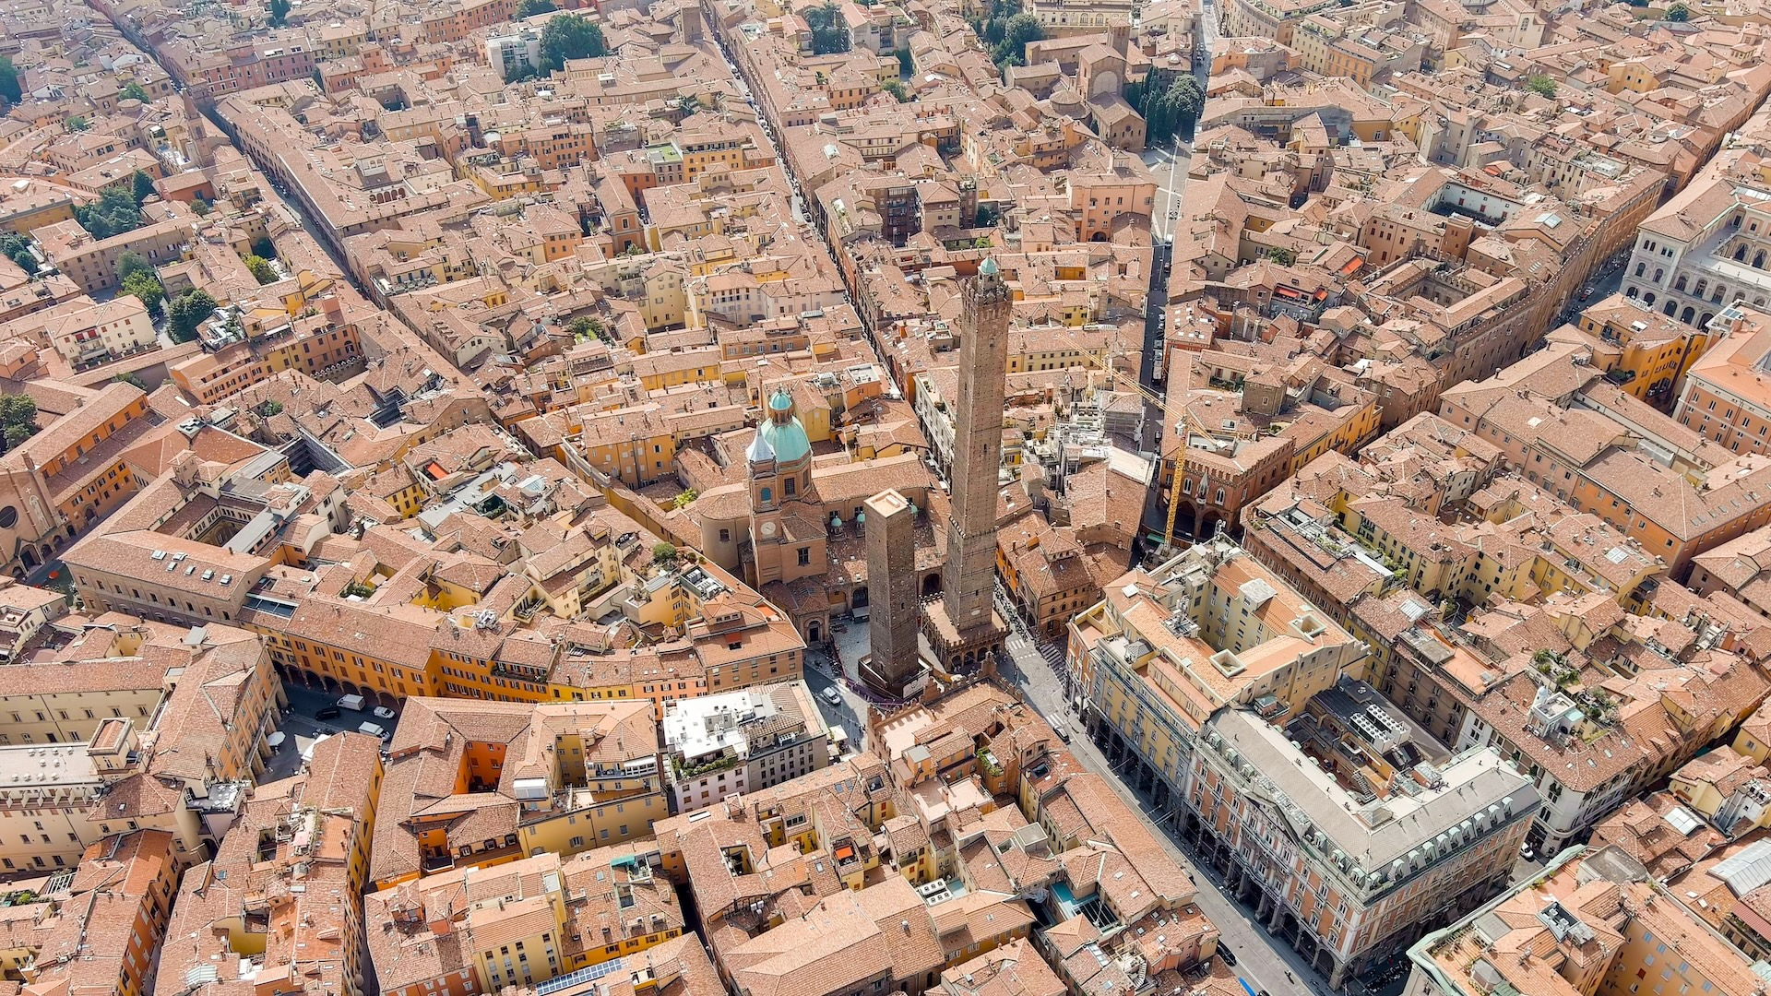

Slide 8
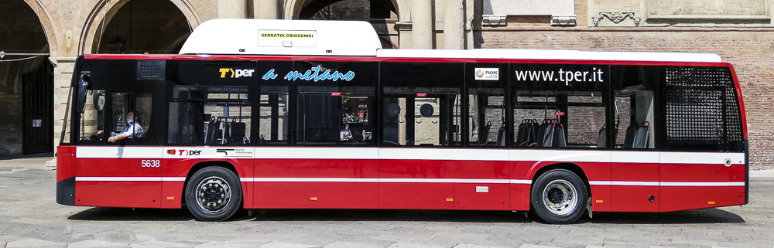

Back to index
  Public transport: buses, regional trains, metro (if available)
  Moving around by bike or on foot
  Useful apps for navigation and maps
  Taxis and ride-sharing services
2 - Getting Around

Slide 9
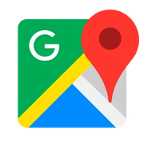

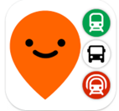
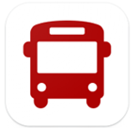


Back to index
Getting around Bologna on foot?
Google Maps makes it easy!
Bologna has a reliable public transport system
USEFUL APPS
for local transports
Including buses and regional trains.
Walking and cycling are popular ways to get around; the city is quite compact.
Buses and local trains are managed by the company TPER (Trasporto Passeggeri Emilia Romagna).
MOOVIT
bus schedules and routes
WE BUS
The construction you see around the city is for the tram system, which is expected to be up and running by 2027

Slide 10


Back to index
  Buy your bus ticket directly on board with a contactless credit card
  If you plan to travel frequently by bus, consider a pass
  Visit the TPER website to explore all available options
  Always have a ticket (or buy one on the bus): fines are high if you don’t
  Tickets bought outside the bus must be validated on board
  Buses run often in the city center, but some lines to the suburbs are less frequent, so check schedules in advance
  Bologna is divided into zones: urban tickets cover the center and nearby areas. Traveling outside the city requires an extra ticket or a multi-zone pass

Slide 11





Back to index
USEFUL APPS
for sharing
Bike & others
RIDEMOVI
Move Smarter: Sharing Apps for Bologna
bike-sharing service with classic and electric bikes.
CORRENTE
sharing service for electric bikes, scooters, and cars.
CARS
ENJOY
car-sharing service with petrol or electric cars.
Got a bike?
Lock it up and keep it visible!
Bike theft is common in Bologna.
CORRENTE
fully electric car-sharing service
Download the apps to learn about rules, prices, and subscriptions.
Click on the icons

Slide 12


Back to index
Bologna has a reliable public transport system
TaxiClick Easy
App to call a taxi via smartphone
COTABO (Cooperativa Taxisti Bolognesi)
Tel. 051-372727
CAT Radiotaxi Bologna
Tel. 051-4590
TAXI 051-0909 – Available 24/7 in Bologna
or
INTAXI APP: www.intaxi.it – or via SMS/WhatsApp: +39 3202041047
Taxis in Bologna are limited, especially at night, so it’s good to have alternatives.
You can’t request a regular taxi via Uber, but Uber Black offers premium rides 24/7 with upfront pricing for last-minute trips.
When You Can’t Find a Taxi
CAR SERVICES
sharing service for electric bikes, scooters, and cars.

Slide 13
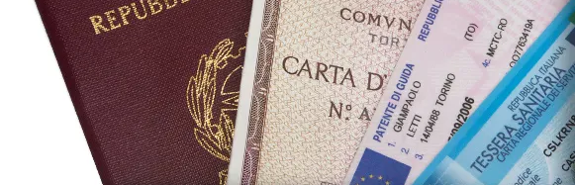
Back to index
3 - Essential
Documents
  Passport, visa, residence permit
  Health insurance and medical documents
  Tips for carrying both paper and digital copies

Slide 14

Back to index
  Always carry your passport, visa, and residence permit (or permit application receipt)
  Keep your health insurance documents handy
  Make digital copies of all important documents in case of loss or theft
  Save emergency contacts and important phone numbers, including 112
  Be mindful of your belongings in crowded places and on public transport

Slide 15




Back to index
Step-by-Step Guide
for entering Italy with a Type D Visa
Discover more here
STEP 1
ARRIVAL IN ITALY
STEP 2
WITHIN 8 DAYS OF ARRIVAL
STEP 3
PREPARE YOUR DOCUMENTS
STEP 4
SUBMIT THE KIT AT POSTE ITALIANE
Show your Type D visa and passport at the border.
Your entry will be stamped on your passport.
No need to declare your presence separately – the stamp is enough
Go to a Poste Italiane “Sportello Amico” to collect your residence permit kit.
The kit includes:
  application form for the residence permit
  pre-paid envelope to send to the Questura (police office)
  instructions on which documents to attach
Attach the required documents:
  Passport (copy of main pages + visa)
  Recent passport photo
  Enrollment certificate from work contract / reason for stay
  Receipt for payment of the “marca da bollo”
  Rental contract or host declaration
You will receive a receipt, this proves your residence permit request is in process.
You will also get an appointment at the Questura for fingerprinting and final processing.

Slide 16
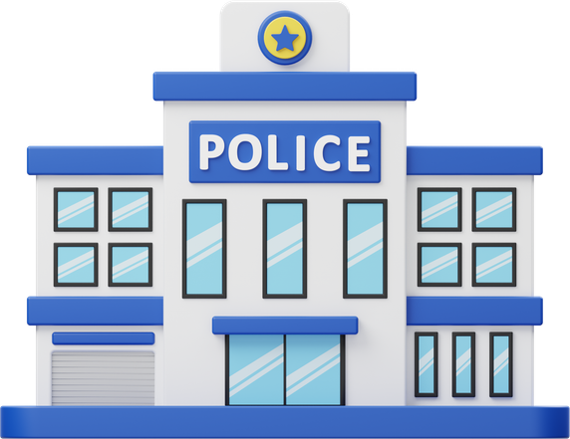
Back to index
Step-by-Step Guide
for entering Italy with a Type D Visa
STEP 5
QUESTURA APPOINTMENT
GO TO YOUR APPOINTED DATE
After completing fingerprinting and verification, you will receive your residence permit, valid for the duration of your visa/study/work.

Slide 17
Back to index
Postal KIT for Residence Permit
What it is
Filling Out & Submitting the Kit
Quick Tips / FAQ
  Forms required to apply or renew a residence permit in Italy
  Available at authorized post offices (Sportello Amico) or some CAF/patronati
Contents of the kit
  Form 1: Personal information of the applicant
  Form 2: For work-related residence permits
Where to get it
  Post offices with Sportello Amico (usually large/central offices)
  Selected CAF/patronati
How to fill it out
  Write in block letters with a black pen
  Attach:
    Valid passport or equivalent travel document
    Supporting documents for your permit type
    Proof of health insurance
Submission steps
  Bring the completed kit and original documents to the Sportello Amico
  Do not sign or seal the envelope – postal staff must review it first
  Receive a receipt as proof of application
  Wait for Questura appointment for photos and biometric data
Costs (typical)
  €16 stamp duty
  €30 registered mail
  €27.50 electronic residence permit
  €80–200 depending on permit type
  The kit is for anyone applying for a residence permit
  Spouses with permits can help with family applications
  The post office sends the kit to Questura; you just hand over the open envelope
For help, CAF offices or specialized lawyers can assist with correct completion

Slide 18

Back to index
4 - Health and Emergencies
  Single emergency number: 112
  Pharmacies, hospitals, emergency rooms
  General safety tips in the city
  Recommended vaccinations

Slide 19
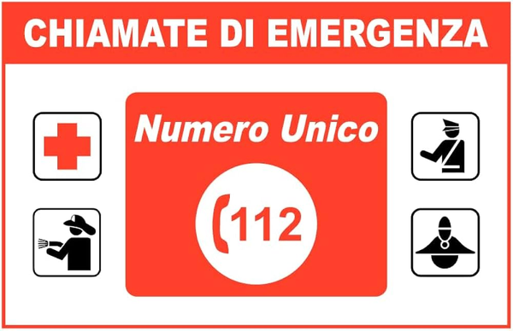


Back to index
Stay aware of your surroundings, avoid poorly lit areas at night, and follow basic safety guidelines.
WITH THE FARMAH24 APP
1 1 2
PHARMACIES ARE WIDESPREAD
you can always find the nearest open.
BENU Farmacia Centrale 24H, located in Piazza Maggiore
is the 24H pharmacy in Bologna.
the single emergency number is 112 for all emergencies
Standard hours are Mon–Fri 8:30–12:30 and 15:30–19:30, but pharmacies may extend them at their discretion.

Slide 20
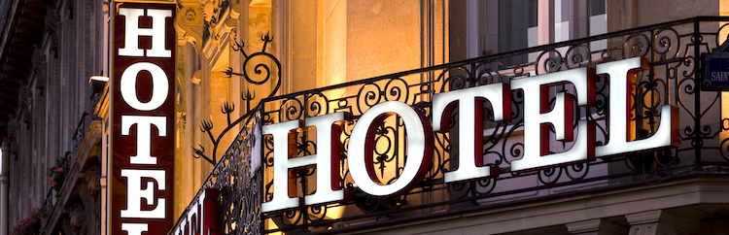
Back to index
5 - Accommodation
  Types of housing: apartments, residences, homestays
  Rental contracts and tenant rights
  Tips to avoid scams

Slide 21



Useful information for finding accommodation in Bologna
Start your search as early as possible, as the rental market in Bologna can be highly competitive.
A temporary solution (hostel, B&B, shared apartment) is often helpful while you look for something long term.
Single rooms and shared apartments are usually the most realistic option for medium or long stays.
The housing market is very competitive, especially at the beginning of the academic year. Start your search early.
Always make sure you have a regular rental contract, especially if you’re a foreign guest.
Always request a written rental contract and read it carefully before signing
Be aware of rental scams, particularly on Facebook and other social media platforms. Always verify the property, landlord, and contract before making any payment.

Slide 22



Websites and platforms for finding accommodation
Click the options
  HousingAnywhere - Rooms and apartments for medium or long stays; easy online booking
  Spotahome - Verified rooms and apartments; ideal if you are not in Bologna yet
  Idealista / Immobiliare.it - Main platforms for private rentals and shared apartments
  SAIS Accommodation Service - Support for international students and researchers; rooms, residences and guidance
  Findallrentals - Apartments for medium and long term rentals across the city
  Subito – Popular Italian marketplace with a dedicated section for rental properties.
  Facebook Groups – Many local groups advertise rooms and apartments in Bologna. Always verify listings carefully and be aware of scams.
If you come across any other useful sites, let us know so we can share them with others who are searching just like you!

Slide 23

Back to index
for Renting Accommodation
Consider the area: places outside the city walls are usually cheaper but may require more bus travel.
NEVER send money before seeing the apartment or signing a contract
Ask whether the landlord can provide the documentation needed for your residence permit application
Watch out for deals that look “too good to be true”
Always check that there is a regular contract, essential especially if you are a foreigner, to ensure you have rights as a tenant
In Italy the power plug sockets are of type F (“Schuko”) and L. Standard voltage is at 230 V and the frequency is 50 Hz

Slide 24
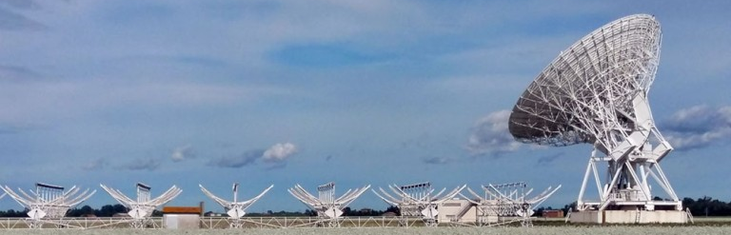
Back to index
  Brief presentation of the institute and main activities
  Useful contacts and offices
  Opportunities for collaboration or visits
  Practical information on access, safety, and internal rules
6 - Institute of Radioastronomy

Slide 25


Back to index
to the Institute of Radio Astronomy!
We explore the universe using radio waves, study galaxies, stars, and planets, and build cutting-edge instruments to understand the cosmos.
The institute has three locations:
Bologna
Medicina (in the province of Bologna)
Noto (in Sicily)
each contributing to our research and outreach activities.
It is an international and interdisciplinary environment where scientists, engineers, and visiting researchers collaborate on innovative projects and contribute to global advancements in radio astronomy.

Slide 26
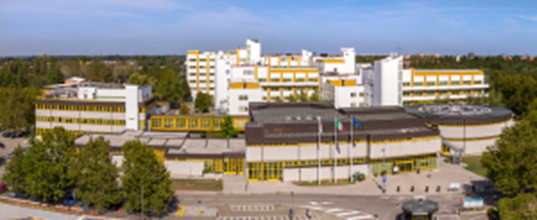




Bologna headquarters of the Institute of Radio Astronomy
within the Bologna Research Area at:
Via Piero Gobetti, 101 – 40129 BOLOGNA (ITALY)
The Bologna site hosts the administrative offices of the Institute of Radio Astronomy, as well as offices for researchers.
It is located within the Bologna Research Area (CNR), which brings together several research institutes in addition to ours, fostering a highly interdisciplinary and collaborative environment. It serves as the central coordination hub for scientific and institutional activities, supporting both day-to-day operations and international collaborations.
ammin@ira.inaf.it
+39 051 639 9385
sito web IRA
Please, note that there will be mosquitoes already in May, especially around the CNR area.
We recommend to bring with you insect repellents.

Slide 27



Directions
The street address is Via Piero Gobetti, 101, 40129 Bologna (the link will take you to the location on google maps). Detailed instructions on how to reach the conference venue can also be consulted here (including bus, train and taxi information from /to the Airport and train station).
The nearest airport to CNR is Aeroporto “G. Marconi”, which is located approximately 10 km from the city center of Bologna. The airport is connected to the main train station Bologna Centrale via the “Marconi express” electric train (more information here).
by car
by train
by bus
from Bologna Centrale railway station:
You can take a taxi (approx. 5 minutes)
or bus.
VEDERE: https://vlbi-40.ira.inaf.it/travel-info/

Slide 28

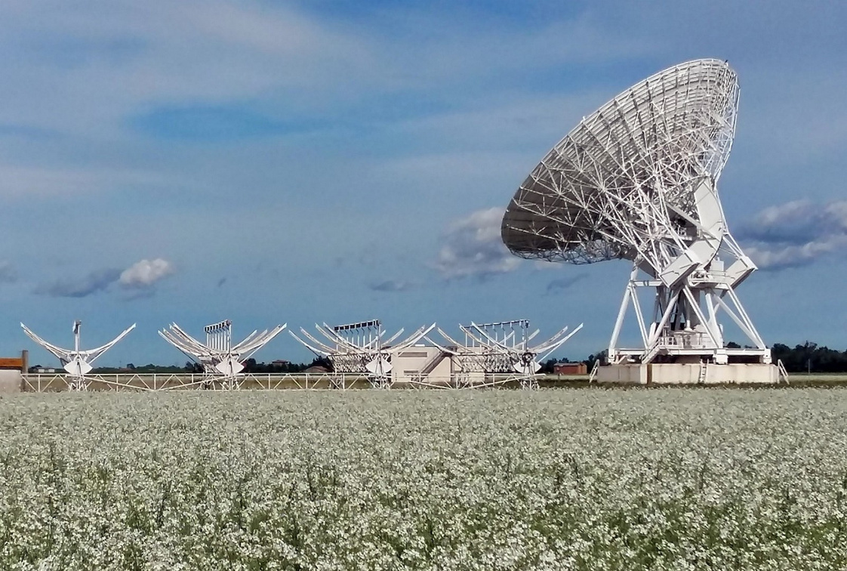
sede di Medicina
Stazione Radioastronomica Medicina
Via Fiorentina 3513 – 40059 Medicina (BO)
ammin@ira.inaf.it
+39 051 6965811

Slide 29

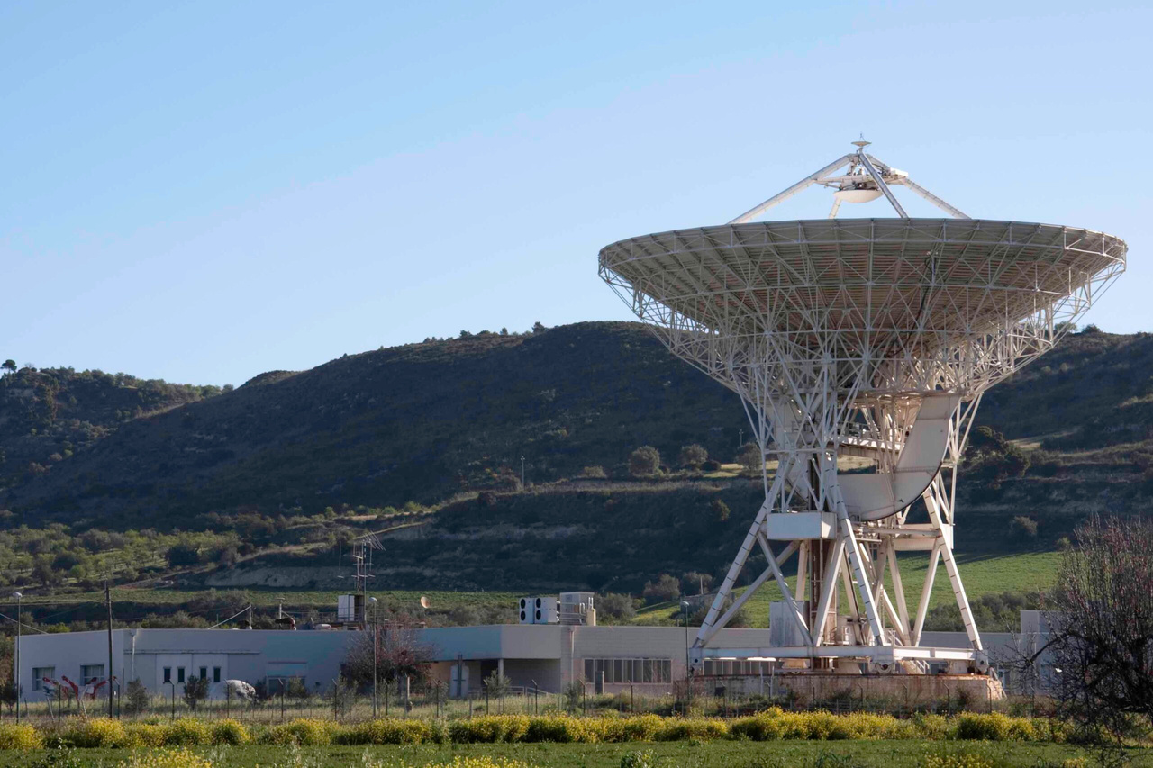
sede di Noto
Stazione Radioastronomica di Noto
Contrada Renna Bassa - Loc. Case di Mezzo – 96017 Noto (SR)
ammin@ira.inaf.it
+39 0931 824111

Slide 30
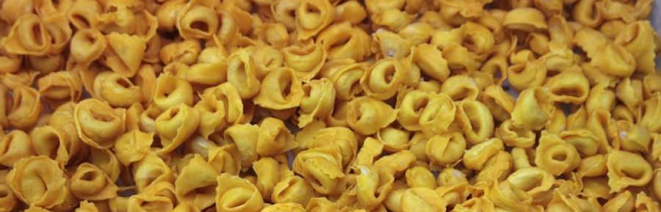
Back to index
7 - Food and Drink
  Typical Bolognese and Italian dishes
  Local markets and grocery stores
  Recommended restaurants, cafés, and trattorias
  Practical advice on meals and meal times

Slide 31


CNR canteen & bar
The CNR has an on-site canteen at Via Piero Gobetti 101, open Monday to Friday from 12:00 to 14:30.
The bar is open from 8:30 to 11:00 and from 12:00 to 15:30.
Restaurants & places to eat near CNR
  Trattoria Vecchio Mercato
Via Piero Gobetti 49/F · cucina italiana · specializzata in piatti GLUTEN FREE.
  Hoops Bistrot
Via Piero Gobetti 91 · bistrot · ideale soprattutto per pranzo e pausa caffè.
  Forchetta e Cuciglio
Via Aristotile Fioravanti 31/C · cucina di pesce · buona opzione per una cena.
  GustaMi
Via Aristotile Fioravanti 5/B · pizzeria · opzione più informale.
  La Nuova Fraschetta
Via Aristotile Fioravanti 53/D · cucina romana/italiana · pranzo e cena.

Slide 32
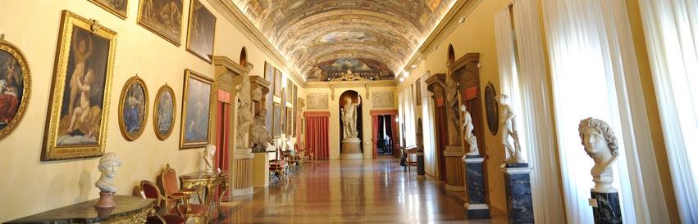
Back to index
8 - Culture and Social Life
  Cultural events, festivals, concerts
  Museums and points of interest
  Social life, associations, sports, and hobbies
  Etiquette and local customs

Slide 33
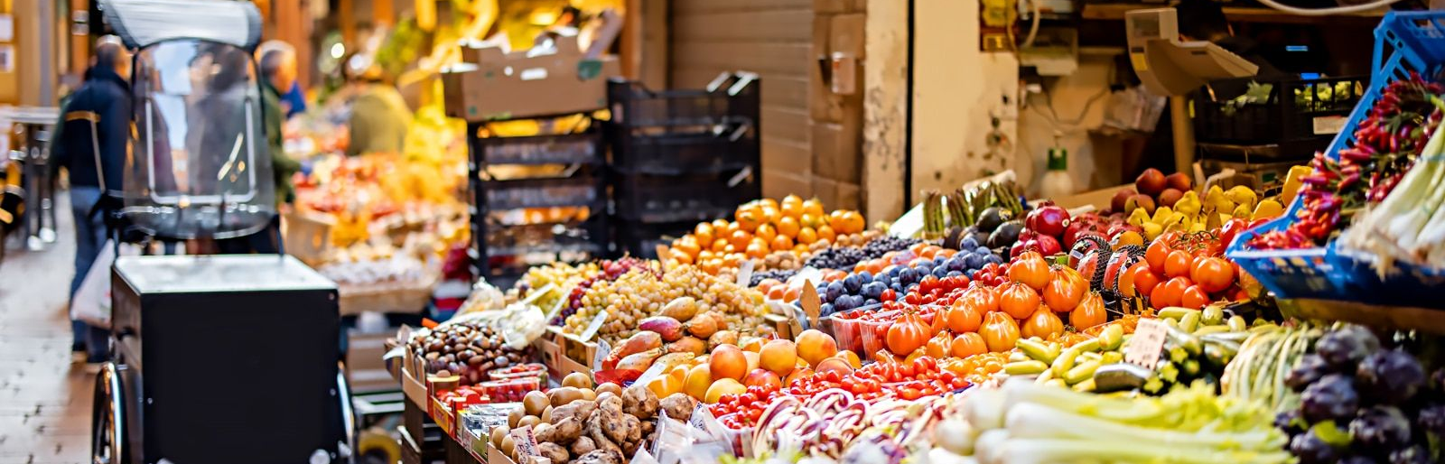
Back to index
  Supermarkets, shops, and local markets
  Banks, ATMs, managing bank accounts
  Post offices and mailing services
  Basic norms of daily life and cultural differences
9 - Daily Life

Slide 34


Your local essentials
Where to find what you need in your neighbourhood
Groceries & supermarkets
🛒 Lidl
Via Piero Gobetti 8 · [Website]
🛍️ Centro Lame
Via Marco Polo 3 · [Website]
🛍️ Centro Navile
Via Cristoforo Colombo 7 · [Website]

Slide 35




Quick Guide to Staying Connected in Italy
SIM or eSIM?
  eSIM: If your phone supports it, this is the fastest option. You can activate it online through services like Airalo, Holafly or Nomad.
  Italian SIM card: Best choice if you're staying more than a few days. Common providers: TIM, Vodafone, WindTre, Iliad. Good coverage and affordable plans.
What you need to buy an Italian SIM
  Passport
  A temporary address in Italy (hotel or B&B is fine)
  Sometimes your Italian tax code (codice fiscale), depending on the provider
Typical plans and costs
For around 7–12 € per month, you usually get:
  70–150 GB of mobile data
  Unlimited calls within Italy
  Reliable nationwide coverage

Slide 36
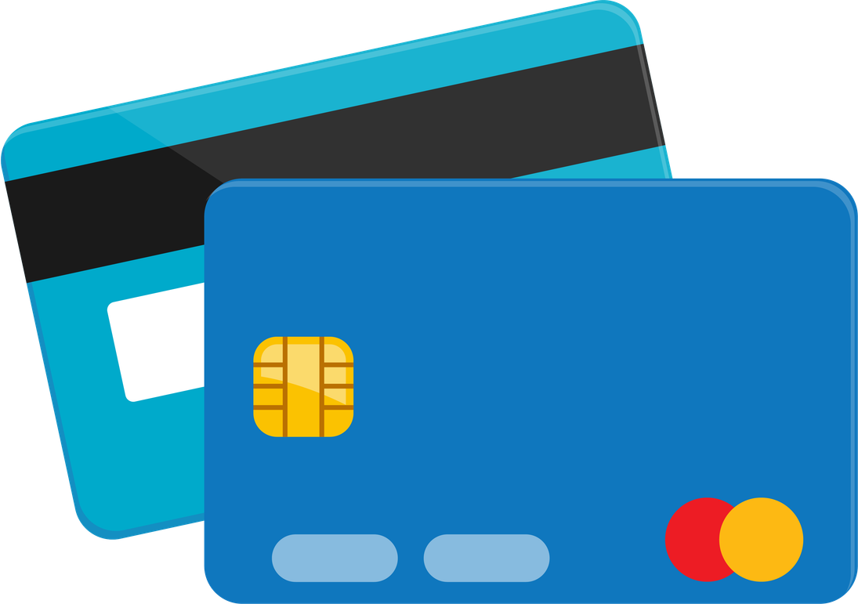
CREDIT CARD
  REVOLUTE
  WISE.COM

Slide 37

Back to index
10 - Language Tips
  Useful phrases for everyday life
  Greetings, thanks, emergencies
  Resources to learn or improve Italian

Slide 38

How to Survive in Bologna
USEFUL PHRASES IN ENGLISH & ITALIAN FOR EVERYDAY LIFE
Greetings & Politeness
Hi! - Ciao!
Good morning! - Buongiorno!
Good evening! - Buonasera!
Thank you - Grazie
You’re welcome - Prego
Mi scusi / Scusa – Excuse me
Arrivederci / A presto – Goodbye / See you soon
Getting Around
Dov’è…? – Where is…?
Quanto costa? – How much does it cost?
Vorrei… – I would like…
Un biglietto per [destination], per favore – A ticket to [destination], please
Emergencies
Aiuto! – Help!
Ho bisogno di un medico / della polizia – I need a doctor / the police
Ho perso il passaporto / il telefono – I lost my passport / phone
Eating & Drinking
Il conto, per favore – The bill, please
Acqua / vino / caffè – Water / wine / coffee
Senza glutine / vegetariano / vegano – Gluten-free / vegetarian / vegan
Useful Phrases
Come va? / Tutto bene? – How’s it going? / Everything good?
Mi chiamo [nome] – My name is [name]
Non parlo molto bene l’italiano – I don’t speak Italian very well
Può ripetere, per favore? – Can you repeat, please?

Slide 39
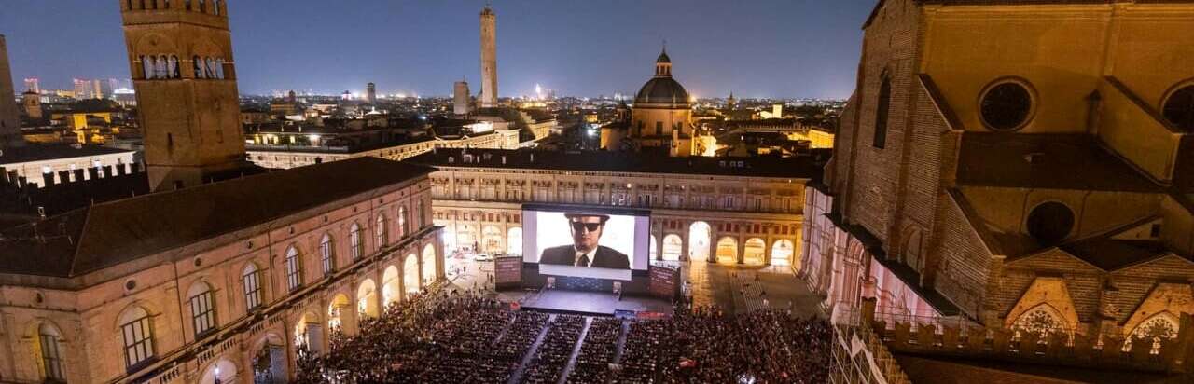
Back to index
11 - Useful Apps and Websites for events and culture
  Events, culture, and social life
  Public services and practical tools for daily life

Slide 40
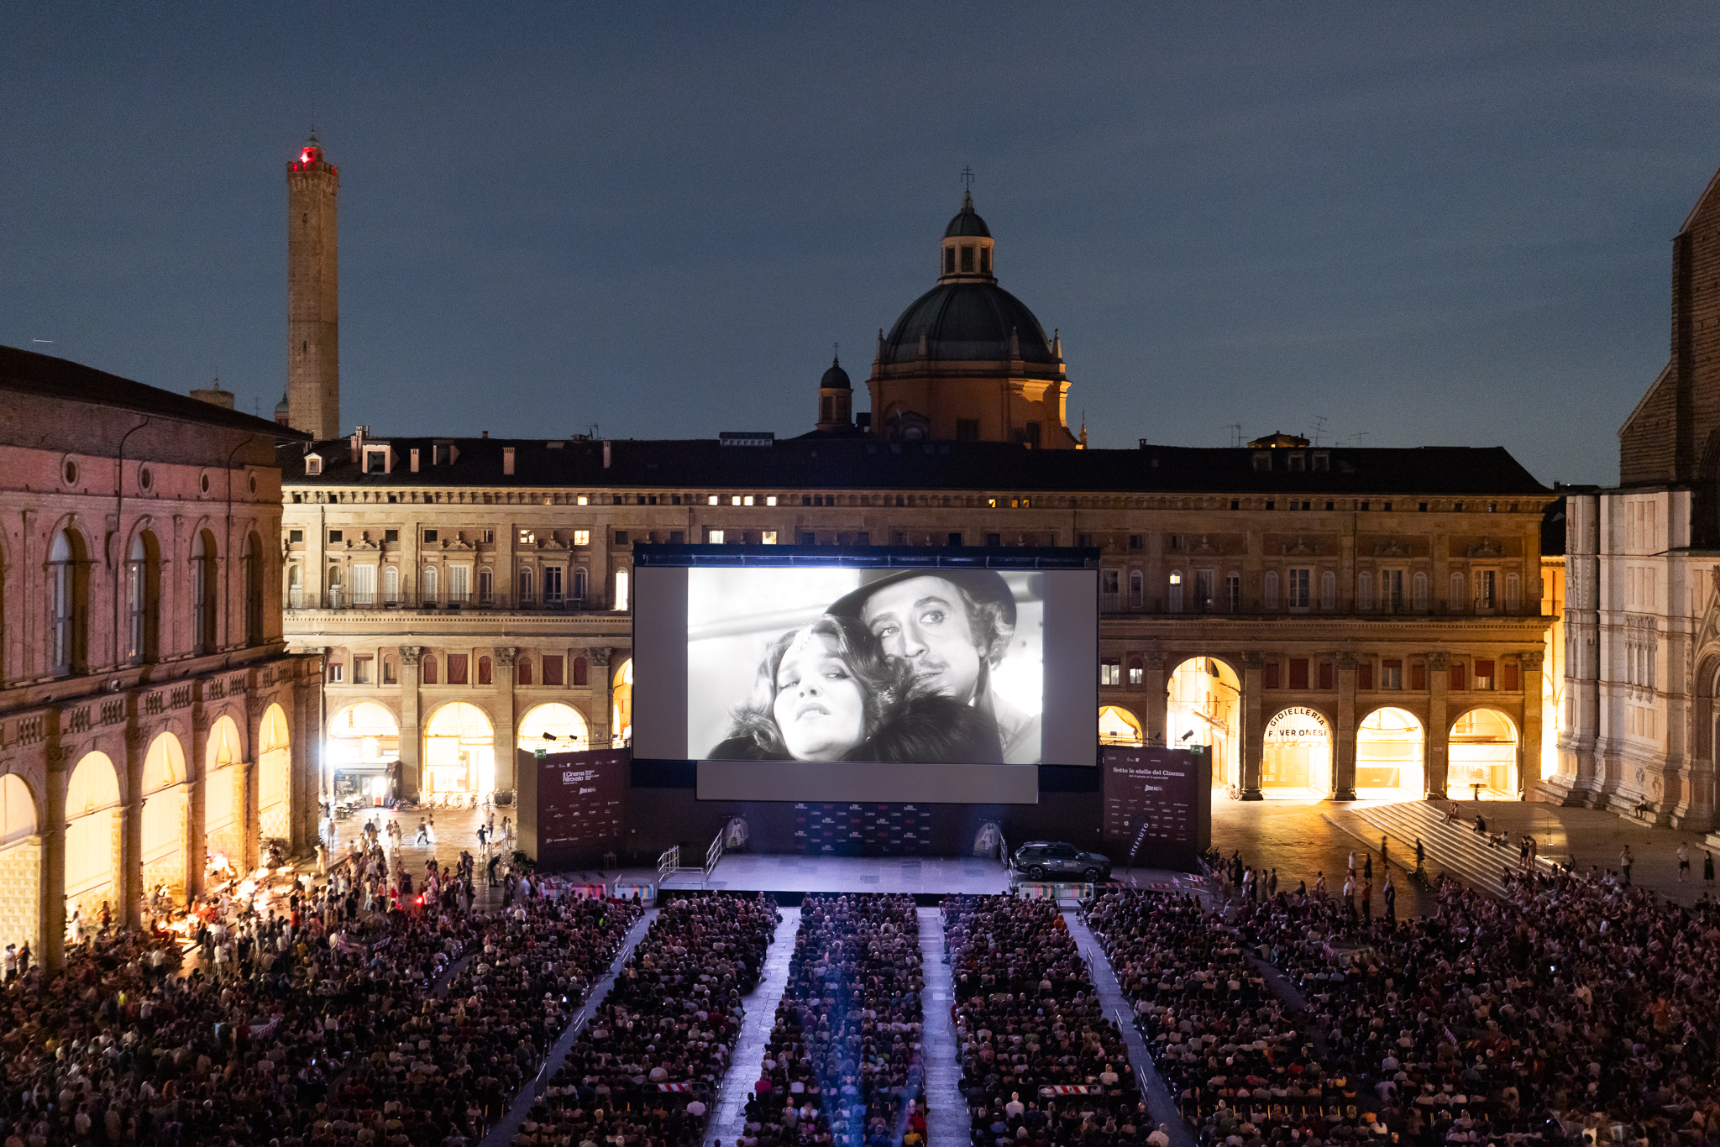

CINEMA UNDER THE STARS
One of Bologna’s best summer traditions is also one of the simplest:
watching a movie under the stars in Piazza Maggiore.
GOOD TO KNOW!
Bologna’s summer cinema is very popular with international visitors too. In 2026, Sotto le stelle del Cinema attracted around 210,000 spectators, confirming its status as one of the city’s most loved summer events.
📍 Where: Piazza Maggiore
📅 When: usually from June to August
🎟️ Admission: free, no ticket required
🌙 Start time: after sunset,

Slide 41










Back to index
Events and culture website
Bologna Musei
All municipal museums with exhibitions, openings, events and guided tours.
Click the options
Agenda Cultura Bologna
Official city calendar for exhibitions, concerts, theatre, talks and cultural events.
Fever
International event-finder app: concerts, immersive events, experiences and special activities
Bologna Welcome
Tourism portal with events, tours, museums, exhibitions, guided visits and cultural highlights.
Eventbrite – Bologna
Workshops, meetups, creative events, networking and cultural happenings.
VisitUp Bologna
Regularly updated listings for concerts, theatre, festivals, nightlife and city events.
MAMbo – Museum of Modern Art
Contemporary art exhibitions, installations, cultural programs.
Questo App
Self-guided tours and themed city walks (mysteries, legends, highlights). Great for exploring.
Città della Musica Bologna
Concerts, music festivals, opera, jazz and live performances across the city
DAMSLab / University Arts Hub
Art, cinema, performances, talks and exhibitions curated by the University of Bologna.

Slide 42




Follow Us!
Join the conversation
connect with our institute on social media!

Slide 43
Grazie!
Thank you!
For internal distribution only. Unauthorized reproduction is prohibited
MFDM©

